Slide 1

Software Development: Data Structures (H16Y35)
Lecture 10 :Hash Tables, Sets, Maps and Collections
c.nyssen@nescol.ac.uk © NESCOL 2020

Slide 2

Welcome to Data Structures (H16Y35) Week 10
This week, in anticipation of the multiple choice in week 12 and the next practical assignment, we will look at Hash Tables, Sets and Maps.

Slide 3
Alternative Data Structures
We have previously looked at lists, where items are stored in sequence and accessed by index number. Index numbers are always integers so they are fast and easy to manipulate. But sometimes index numbers are not appropriate.
If we have an address book entry, for example, with index number 56, that number doesn't tell us much. There is nothing to link a particular contact with number 56. It just happens to be the next available position in the list.
A better structure might be to use a string as the key – this gives us the concept of a dictionary.

Slide 4

Dictionary Structures
A dictionary uses a keyword instead of an index number. An example of this could be an address book or contacts list. So, if that contact was called Ron, we would probably use the keyword Ron; instead of accessing the contact by calling contacts [56], we would use contacts [“Ron"].
Dictionaries are often built using hash tables. As the name suggests, hash tables rely on a concept called hashing, to ensure that each keyword is uniquely referred to in memory.

Slide 5
Hashing
Hashing is the concept of converting data of arbitrary size into data of fixed size.
A little bit more specifically, we are going to use this to turn strings, or other data types, into integers (this sounds a lot more difficult than it actually is).
We will hash the expression hello world, that is, get a numeric value that we could say represents the string. By using the ord() function, we can get the ordinal value of any character.
For example, the ord('f') function gives 102. To get the hash of the whole string, we could just sum the ordinal numbers of each character in the string.

Slide 6
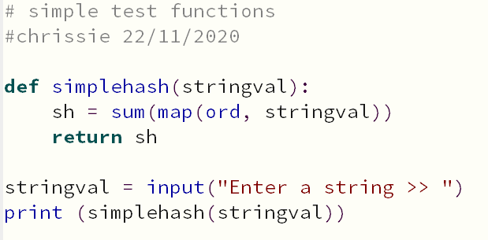
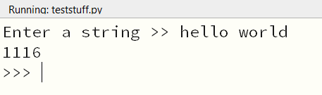
Simple hashing

Slide 7
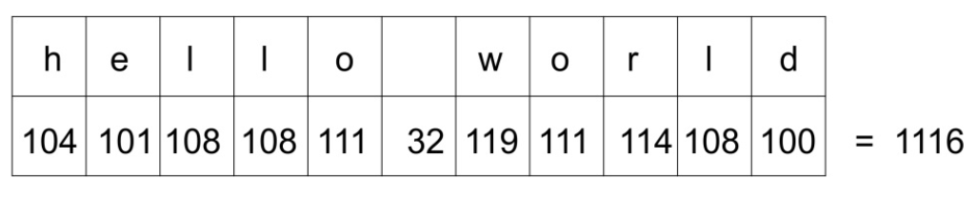
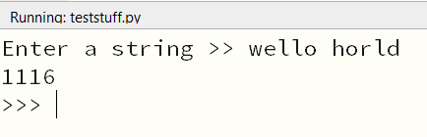
Imperfect hashing
However, we could change the order of the characters in the string and get the exact same hash:

Slide 8
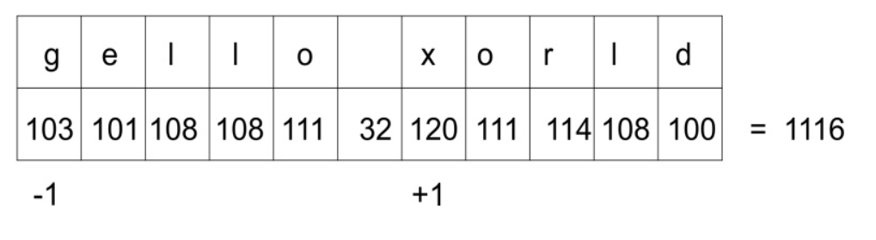
Imperfect hashing
The sum of the ordinal values of the characters would be the same for the string gello xorld as well, since g has an ordinal value which is one less than that of h, and x has an ordinal value that is one greater than that of w, so they balance each other out -
.

Slide 9
Perfect hashing functions
A perfect hashing function is one in which each string is guaranteed to be unique. In practice, hashing functions need to be very fast, so trying to create a function that will give each string a unique hash value 100% of the time is normally not possible.
Instead, we live with the fact that we sometimes get collisions (two or more strings having the same hash value), and when that happens, we come up with a strategy for resolving them.
One method of at least limiting the number of collisions is to add a multiplier, so that the hash value for each character becomes the multiplier value, multiplied by the ordinal value of the character. The multiplier then increases as we progress through the string.

Slide 10
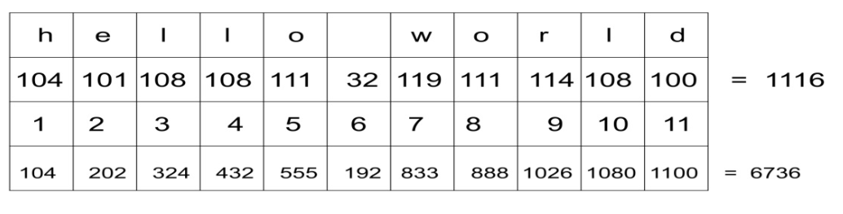
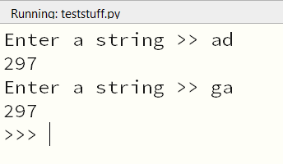
Not-quite-perfect hashing functions
Note that the last row is the result of multiplying the values in rows 2 and 3 such that 104 x 1 equals 104, as an example. This time we get different hash values for our strings.
This is still not a perfect hash. Let us try the strings ad and ga:
(This doesn't have to be a problem, but we do need to devise
a strategy for resolving collisions. )

Slide 11
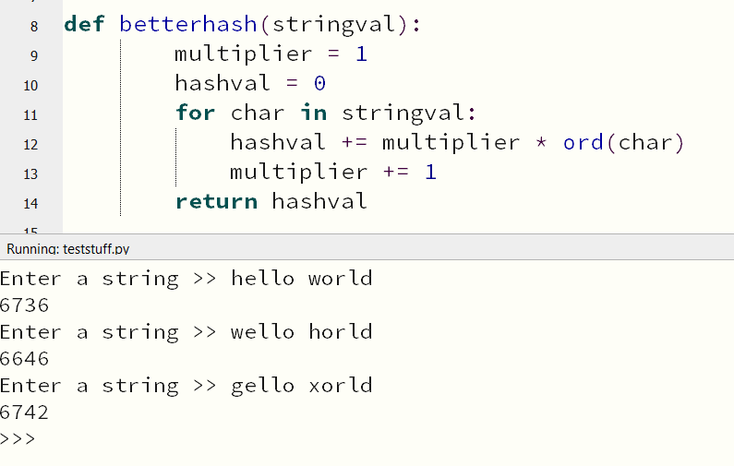
Improved Hashing function using a multiplier

Slide 12
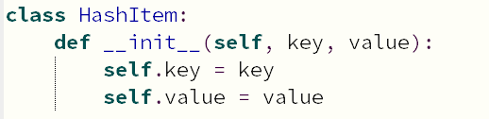
Hash Table Implementation
A hash table is a type of list where elements are accessed by a keyword rather than an index number.
Internally, it uses a slightly modified version of our hashing function in order to find the index position in which the element should be inserted. This gives us fast lookups, since we are using an index number which corresponds to the hash value of the key.
Start by creating a class to make hash table items. These need to have both a key and a value.

Slide 13
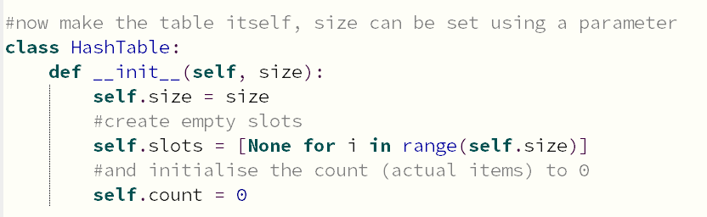
Hash Table Implementation
This hash table uses a standard Python list to store the elements (a linked list would work as well).
Set the size of the hash table to however many elements you want (the elements are often referred to as slots or buckets).
Finally, add a counter for the number of actual hash table elements we have.
Size of a table refers to the total number of slots in the table.
Count of the table refers to the number of slots that are filled with actual key-value pairs.

Slide 14
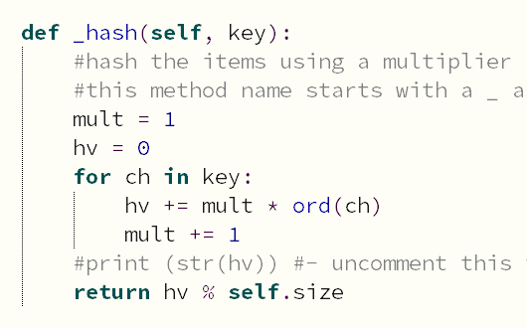
Hash Table Implementation
Now add the hashing function to the table. It will be similar to the one we already saw, but we also need to ensure that the hashing function returns a value between 1 and the size of the table.
One way of doing so is to return the modulus (remainder) of dividing the hash by the size of the table.
As the hashing function is only meant to be used internally by the class, we put an underscore(_) at the beginning of the name to indicate this.
For now, assume that keys are strings; the _hash() function is going to generate the hash value of a string.

Slide 15
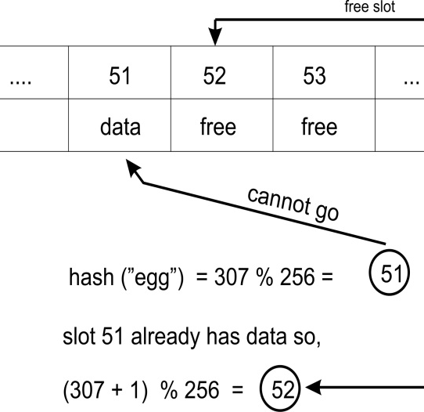
Putting Elements
We add elements to the hash with the put() function and retrieve with the get() function.
To put(), start by embedding the key and the value into the HashItem class and computing the hash of the key.
Now we need to find an empty slot. We start at the slot that corresponds to the hash value of the key. If that slot is empty, we insert our item there.
(Note that this particular hashtable has 256 buckets).

Slide 16
Putting Elements
However, if the slot is not empty and the key of the item is not the same as our current key, then we have a collision.
This is where we need to figure out a way to handle a conflict.
We do this by adding one to the previous hash value we had and getting the remainder of dividing this value by the size of the hash table.
Remember to increase the count by 1!

Slide 17
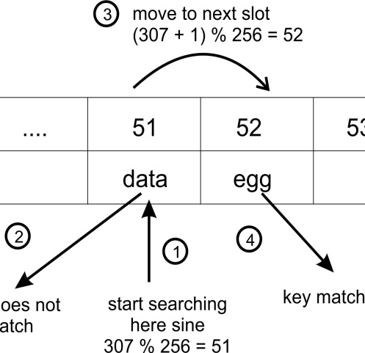
Getting Elements
The implementation of the get() method should return the value that corresponds to a key.
We also have to decide what to do in the event that the key does not exist in the table.
We start by calculating the hash of the key, then start looking through the list for an element that has the key we are searching for, matching the hashes.

Slide 18
Getting Elements
If the current element is not the correct one, then, just like in the put() method, we add one to the previous hash value and get the remainder of dividing this value by the size of the list. This becomes our new index.
If we find an element that contains None, we stop looking.
Finally, we decide what to do if the key was not found in the table. We can choose to return None, or raise an exception.

Slide 19
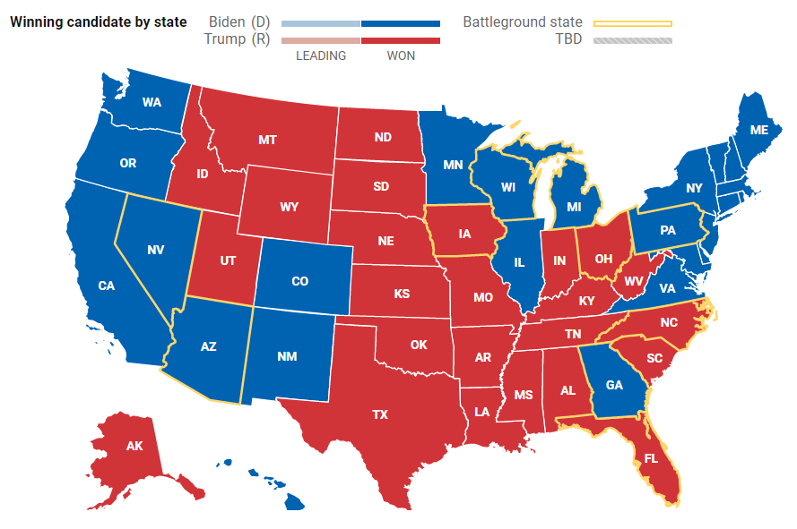
Exercise
Download and run the sample code for a hash table, and ensure that you understand it. (There is no requirement to implement your own hash table, but there will be questions about them in the multiple choice assignment).
Add a few more elements of your own and also try to get() a key that does not exist.
Assume that there is a new state called Alternative Dimension, or AD. Add values for both GA and AD – remember that those two values caused a collision earlier. Are they properly handled now?

Slide 20

Hash Tables – Practical Example
Symbol tables are used by compilers and interpreters to keep track of the symbols that have been declared and information about them. These are often built using hash tables, since it is important to efficiently retrieve a symbol in the table.
The two symbols, name and age belong to a namespace (which could be __main__, or some module). Each symbol has a value; name has the value Joe and age has the value 27.
A symbol table allows the compiler or the interpreter to look these values up; name and age are the keys in the hash table.

Slide 21
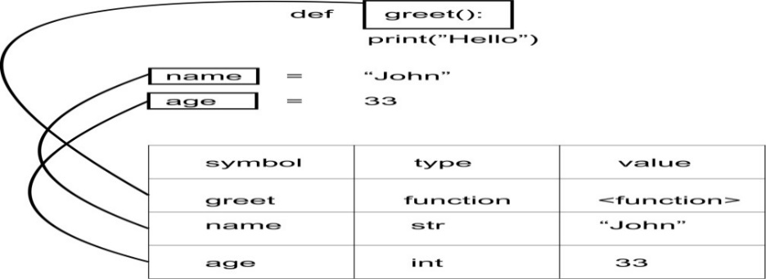
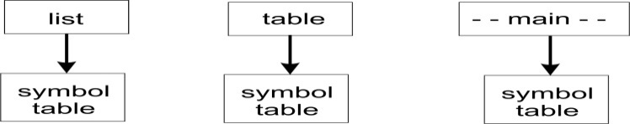
Symbol Tables
Not only variables are symbols, but functions and classes as well.
They will all be added to our symbol table, so that when any one of them needs to be accessed, they are accessible from the symbol table.
In Python, each module that is loaded has its own symbol table. The symbol table is given the name of that module.

Slide 22
Sets
Sets are unordered collections of unique items. Basic sets are mutable; we can add and remove items from them, but the items themselves must be immutable.
Sets are typically used to perform mathematical operations such as intersection, union, difference, and complement.
Set types do not provide any indexing or slicing operations. There are also no keys associated with values, as is the case with dictionaries; but like dictionaries, sets cannot contain duplicate items.
Sets are created using comma-separated values within curly braces. To create an empty set, we write either a=set() or a=frozenset(); we cannot create an empty set using a={}, because this will create a dictionary.

Slide 23
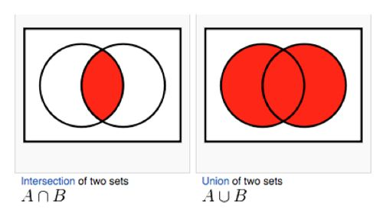
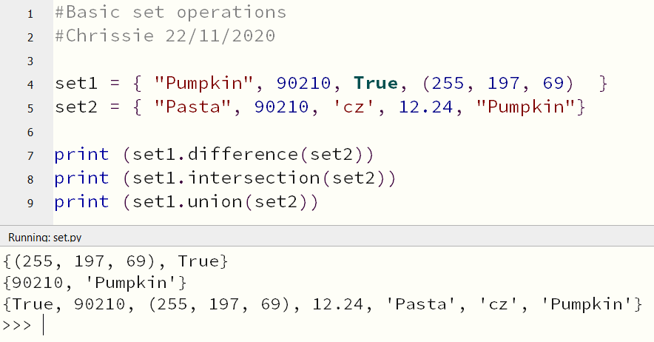
Set Operations
The set object does not care that its members are not all of the same type, as long as they are all immutable (if you try to use a mutable object in a set, for example a list, you will get an unhashable-type error).

Slide 24
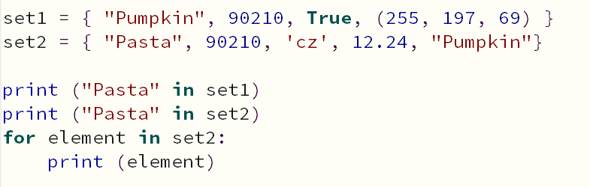
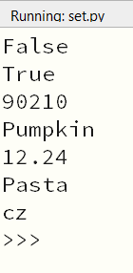
Set Operations
We can test for membership of a set, and loop through elements in a set.
Note that Python also has an immutable set type called frozenset. It works pretty much exactly like set apart from not allowing methods or operations that change values such as the add() or clear() methods.

Slide 25
Set Operations – Full List
Method | Operators Description
len(s) |  | Returns the number of elements in s
s.copy() |  | Returns a shallow copy of s
s.difference(t) | s - t- t2 - ... | Returns a set of all items in s but not in t
s.intersection(t) |  | Returns a set of all items in both t and s
s.isdisjoint(t) |  | Returns True if s and t have no items in common
s.issubset(t) | s <= t s < t (s != t) | Returns True if all items in s are also in t
s.issuperset(t) | s >= t s > t (s != t) | Returns True if all items in t are also in s
s.symmetric_difference(t) | s ^ t | Returns a set of all items that are in s or t, but not both
s.union(t) | s | t1 | t2 |... | Returns a set of all items in s or t

Slide 26
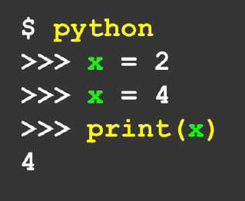
Collections
The term “collection” means a container for more than one variable, that we can carry around in one convenient package. We have places “in” the container for each individual variable and we can refer to them by their places.
When we declare a variable, it has one value only in it; every time we redeclare it, the original value is overwritten.
Lists and Dictionaries are both collections.
A list is a linear collection of values that stay in order.
A dictionary is a “bag” of values, each with it’s own label.

Slide 27

Collections
Dictionaries are Python’s most powerful data collection, and allow us to do fast database-type operations.
These have different names in different languages –
Associative Arrays (Perl, PHP)
Properties, Map, Hashmap (Java)
Property Bag (C#, .Net)
See https://en.wikipedia.org/wiki/Associative_array

Slide 28
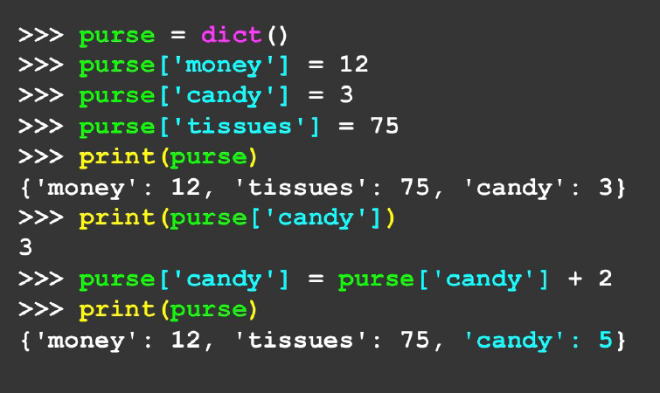
Collections
Lists index things by their position in the list, dictionaries are like bags (no order).
So we have to index things with a key, exactly like the hashtable.

Slide 29
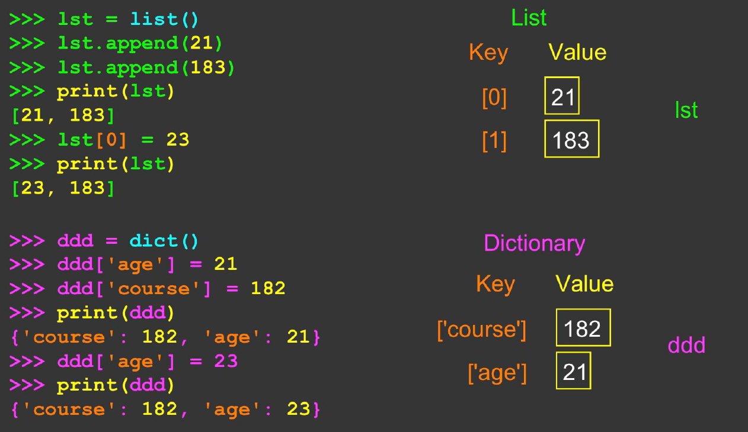
Python List compared to Python Dictionary – dictionary literals use curly braces {} like a set, and key:value pairs like a hashtable. Make an empty dictionary like this – myDict = {} add things like this – myDict [“PST”] = -8 myDict [“IST”] = 5.5

Slide 30

More Python Dictionaries
The final practical assignment will involve building an application with a Python dictionary.
As this is quite a lengthy topic, we will look at some practical examples of Python dictionaries next week.
I will not release the fourth practical assessment until week 12.

Slide 31
Further Reading
https://rise.articulate.com/share/Q65g7fNY_sgJqna9VBoodRA4yPfs5IJ7#/lessons/vyBkNiyQO4ZcLO_iJNM8ml2nswnJ3FB8
https://www.sanfoundry.com/python-program-implement-stack-using-linked-list/#:~:text=Python%20Program%20to%20Implement%20a%20Stack%20using%20Linked,if%20there%20are%20no%20nodes.%20More%20items...%20
These two links are important and you should investigate them before attempting Practical Assessment 3.

Slide 32
Further Reading
https://rise.articulate.com/share/Q65g7fNY_sgJqna9VBoodRA4yPfs5IJ7#/lessons/vyBkNiyQO4ZcLO_iJNM8ml2nswnJ3FB8
https://en.wikipedia.org/wiki/Associative_array
These two links are important and you should investigate them before attempting the Multiple Choice.

Slide 33
Thanks For Watching

